Slide 1
Accessible (Virtual) Presentations

Slide 2
Today's presenter
Brian Elton
Training Practice Manager
belton@vispero.com

Slide 3

Interaction notes
Auto-captions are available
Ask questions in chat/Q&A
Use the raise hand feature to come off mute

Slide 4
Agenda
Understanding Disability
Accessibility challenges with virtual presentations
Virtual platform accessibility support
Designing accessible presentation content
Managing accessible presentations and meetings
Participant considerations

Slide 5
Introduction
Virtual meetings and presentations have become very commonplace
While all presentations can have challenges for people with disabilities, virtual presentations have amplified some of those challenges.
Always assume that your audience will include people with disabilities, and you should take steps to be inclusive
Shared visual material, lack of captions or transcripts, poor technology - all can lead to people with disabilities feeling excluded

Slide 6
Understanding Disability

Slide 7






People with disabilities
Vision disabilities
People who have limited sight, no sight, or are color blind
Physical disabilities
People who have dexterity or movement issues
Motion/vision sensitivities
People who are sensitive to movement or flickering/flashing
Deaf/Hard of hearing
People who cannot hear or have limited hearing
Cognitive disabilities
People with learning and attention difficulties, including autism spectrum conditions
Speech disabilities
People who have difficulty producing recognizable speech

Slide 8

Age-Related Impairments
Many people develop age-related impairments
Includes reduced vision, hearing loss, mobility, manual dexterity, and cognition

Slide 9
Other impairments
Situational impairments
Parents looking after young ones while trying to focus on the presentation
Attending a presentation while stressed about other work
Attending a presentation on a mobile device
With glare from the sun, making the screen difficult to see
While in a crowded place, where it's difficult to hear
Temporary disabilities
A broken arm, making typing more difficult
An ear infection, making it temporarily difficult to hear
RSI or Carpel Tunnel Syndrome, making it temporarily difficult to use your hands
A migraine, making it temporarily difficult to think... see... talk...

Slide 10
Accessibility Challenges for Virtual Presentations

Slide 11
Deaf / Hard of Hearing

Slide 12
Specific Challenges - Deaf/HoH
Cannot hear speaker
Cannot follow along with audio in uncaptioned or poorly captioned videos
May not understand written language as well if sign language is their first language
May have trouble lip reading if the speaker's mouth is not visible or is obstructed

Slide 13
Vision Impairments: Blind

Slide 14
Specific Challenges - Blind
Cannot see visual information
Images or graphs
Action in video
Needs to be able to operate the virtual meeting platform by a keyboard alone

Slide 15
Vision Impairments: Low Vision

Slide 16
Specific Challenges - Low Vision
May not be able to differentiate between colors
May not be able to see text with low contrast
May not be able to see small text on screen
May not be able to see visual information
Images or graphs
Action in video

Slide 17
Physical Disabilities

Slide 18
Specific Challenges - Physical Disabilities
Needs to be able to operate the virtual meeting platform by a keyboard or keyboard interface device alone
May not be able to easily participate in typed chat discussions
May require more time to answer questions or otherwise participate

Slide 19
Cognitive, Intellectual, and Developmental Disabilities

Slide 20
Specific Challenges - Cognitive Disabilities
May be easily distracted
May be overwhelmed by too much text on screen
May have trouble reading text that has certain formatting (justification, serif fonts, italics, etc.)
Could react to animations or other moving or blinking content
Could find participating in the presentation anxiety inducing
May require more time to answer questions or otherwise participate

Slide 21
Virtual Platforms: Accessibility Support

Slide 22
Types of Possible Interactions
Audio/video presentation
Shared content - slides, video or audio from participants
Chat
Emoji reactions
Formal question and answer management
Breakout rooms

Slide 23
Technology
Virtual presentations rely on technology
Many different platforms to choose from
Learning curve, some platforms more accessible than others
Strong Internet connections are needed for best clarity

Slide 24

Microsoft Teams
Auto-generated or third-party (CART) captioning
Auto-generated can be translated in real time
Share slides in real time with PowerPoint Live
Sign language view for consistent on-screen location
Lots of screen reader support information
Lots of settings for other accessibility features
Voluntary Product Accessibility Template (VPAT)/Accessibility Conformance Report (ACR) available for each platform
https://support.microsoft.com/en-us/office/accessibility-tools-for-microsoft-teams-2d4009e7-1300-4766-87e8-7a217496c3d5

Slide 25
Microsoft Teams - sharing live content
Teams allows presenters to share content in real time
When presenting slides, if you use PowerPoint Live instead of traditional screen sharing
Attendees navigate slides independently
Works better with screen readers
Allows zoom, contrast adjustments, and personalized views
Enables access to links within slides
For sensitive information, there is an option for "Private View" where attendees can not move through the slide independently of the presenter
Can also share Excel files where attendees can interact with the sheet data

Slide 26
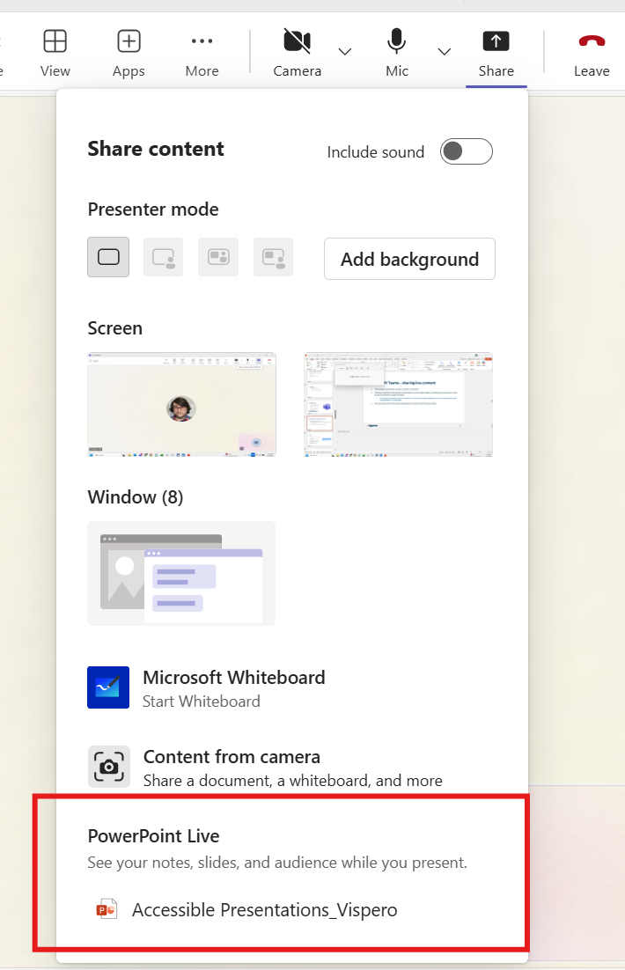
Sharing PPT Live

Slide 27
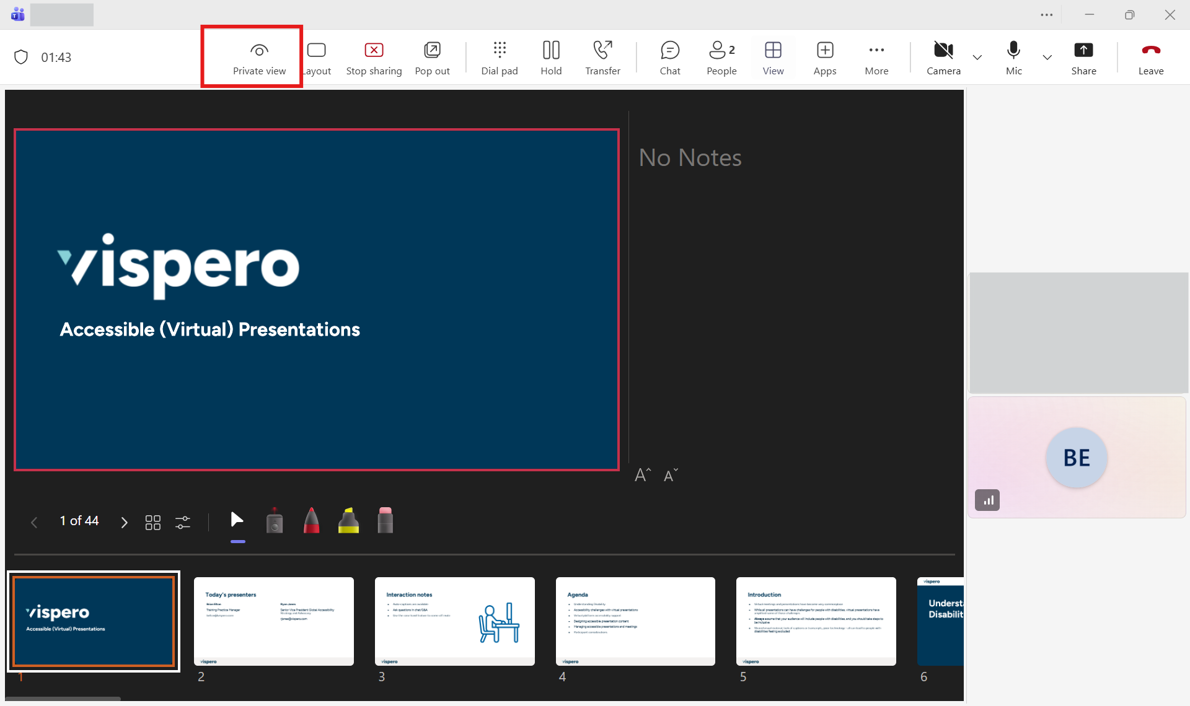
Presenter view of PPT live

Slide 28

Zoom
Auto-generated, manual, or third-party captioning
Live transcription
Meeting host can spotlight the sign language interpreter
Rearrangeable gallery view
Various settings for display, keyboard, screen reader support
Voluntary Product Accessibility Template (VPAT)/Accessibility Conformance Report (ACR) available for each platform
https://explore.zoom.us/en/accessibility/

Slide 29
Other virtual meeting platforms
Webex
Has made improvements but is still less accessible than Teams and Zoom
Google Meet
Less common professionally, but used a lot in education settings
Has lots of documented accessibility features (we welcome feedback on personal experience)

Slide 30
Designing Accessible Presentation Content

Slide 31
Text Content
Write clear and understandable content
Use simple language for general audiences
Keep content on each slide brief
Use simple font faces (sans serif)
Have a consistent design in slides (reduce cognitive load)
Have an overview at beginning and summary at end
All text must have sufficient color contrast, including text overlaying images

Slide 32
Images, graphs, video
Do not use color alone to provide information
Bar graphs, pie charts, etc.
Use other visual indications, such as patterns or icons
Keep images simple and easily understandable
Do not use animated images
Ensure all videos have legible captions and audio description

Slide 33
Managing Accessible Meetings and Presentations

Slide 34
Setting Up
Ensure all registration processes are accessible
Ask for accommodation needs in invite/registration process
Provide accessible documents ahead of time
Source sign language interpreters and plan a way for them to contribute
Ensure caption/transcription features are enabled in the virtual platform

Slide 35
While Speaking
Ensure your microphone is positioned well to capture your voice
Speak at a reasonable and steady pace, and try to be as clear as possible
Easier for both participants and captioners/sign language interpreters (both live and automated)
Avoid slang and colloquialisms
Avoid acronyms, unless well understood by your audience
Use your camera if you are comfortable in doing so
Can help with group engagement and help Deaf or Hard of Hearing participants who may be lip reading

Slide 36
While Speaking (2)
Use inclusive language that avoids "othering" people with disabilities
Say things like "Those of us who have disabilities" rather than talk about "them" as if they're not in the room
While trying to be inclusive, be mindful to not over do it
Over-describing content (or self)
Fretting about using language that might seem offensive but generally isn't (e.g. asking a blind person "did you watch the Super Bowl last night?" isn't typically offensive)
Being fundamentalist about using specific disability language when there are valid regional and disability-group differences in preference (e.g. people-first vs identity-first language)

Slide 37
Inform participants about accessibility features and best practice
Inform participants of the interactive features of the virtual platform and when to use them
Chat, Q&A for text-based interaction
Raising hand to come off mute
Inform participants of the availability of captioning and/or transcript, and whether it is automated or live captioning
If a sign language interpreter has been provided, provide instructions on how to pin their video

Slide 38
Describe what's going on
Describe visual content, don't assume everyone can see it
Try to avoid saying things like "as you can see" or "as this shows"
If pointing at something with your mouse, use high contrast mouse and describe what you are doing
Announce any visual actions within the "room" (results of a poll where participants raise hand)
Give warning to people when switching mode of presentation (starting a video, switching to an application away from the presentation, etc.)

Slide 39
Provide flexibility
If showing videos, inform the group when it is about to start, and that there are captions and audio description
If there is no audio description, provide it yourself as the video plays
Do not assume all participants are connecting in the same way
Could be connecting via desktop, laptop, mobile device, phone only, etc.
Don't require all questions happen via chat/Q&A
Allow participants to raise hand and come off mute to ask questions
Or pause the presentation and explicitly give an opportunity to come off mute
Make sure to repeat questions to ensure all can hear and/or it can be captioned

Slide 40
Things to watch out for ("Gotchas")
Avoid Background noise
Avoid potential distractions
Video background
Movement in background (ceiling fan, pets, children)
Know how to mute all participants
Ensure Internet connect is strong

Slide 41
Participant Considerations

Slide 42
Be a respectful participant
Use the features available to participate
Chat, Q&A, raise hand
Stay muted unless speaking
Announce yourself when you start speaking
If possible, request necessary accommodations in advance of the presentation
Ideally this is part of the registration process

Slide 43
Conclusion
Ensure registration processes are accessible, ask attendees for any accommodations needed
Provide materials ahead of time
Ensure your presentation content is clear and concise, use simple imagery to convey information
Use easy to read fonts, have strong contrast
Describe visual content, enable captions and transcripts
Take advantage of the accessibility features of the virtual platform
Ensure attendees can participate in a way that is comfortable for them

Slide 44
References
Making Events Accessible: Checklist for meetings, conferences, training, and presentations that are remote/virtual, in-person, or hybrid (https://www.w3.org/WAI/teach-advocate/accessible-presentations/)
Accessible Presentation Guide | SIGACCESS (https://www.sigaccess.org/welcome-to-sigaccess/resources/accessible-presentation-guide/)
Accessible Virtual Conferences | SIGACCESS (https://www.sigaccess.org/accessible-virtual-conferences/)
The Inclusive Speaker: How to Truly Connect With All of Your Audience Without Leaving Anyone Behind - Denis Boudreau

Slide 45
Questions?
Thank you for attending!

Slide 46
Connect with us
Website
www.Vispero.com
US Headquarters
727-803-8000
European Headquarters
+31 88 67 83 444
Vispero's assistive technology and digital accessibility expertise open doors to independence and inclusion for all.

