Slide 1
Inclusive by Design Using WCAG to Improve Usability For Everyone
David Sloan and David Swallow, Vispero
May 19, 2026

Slide 2
Outline
The relationship of technical accessibility and inclusive user experience
How the Web Content Accessibility Guidelines (WCAG) support inclusive user experience design
Optimizing accessibility processes for improved user experience

Slide 3
1. Technical accessibility and inclusive user experience

Slide 4
What do we mean by inclusive user experience design?
"an approach to create accessible products and experiences that are usable and understandable by as many people as possible. It goes beyond accessibility to consider users' diverse needs, backgrounds and experiences." (Inclusive Design Foundation)
"methodologies to create products that understand and enable people of all backgrounds and abilities. It may address accessibility, age, economic situation, geographic location, language, race, and more." (Alita Kendrick, NN Group)

Slide 5

Inclusive design and accessibility
Inclusive design generally extends to accommodating multiple ways in which humans differ
Humans belong to multiple groups defined by a characteristic, so inclusive design recognizes and accommodates intersectionality
Given the GAAD focus of this webinar, we'll concentrate on accessibility and disability
A focus on accessibility helps product teams pay attention to and accommodate diversity

Slide 6
The role of accessibility standards in inclusive UX
  A distillation of global accessibility knowledge into formal language
  A baseline of requirements applicable across broad contexts
  Support measurement of a digital product's accessibility or the process used to create the product
  A reference that can be used to support compliance with applicable laws
  We have many useful accessibility standards, including:
    Section 508 ICT Accessibility Standards
    EN 301 549
    Web Content Accessibility Guidelines (WCAG)
    ISO 30071-1 Information technology - Development of user interface accessibility

Slide 7
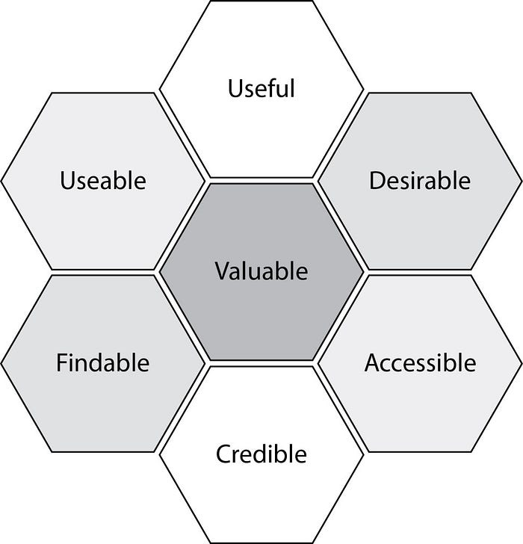
Accessibility as part of the user experience
Peter Morville's "UX honeycomb" shows how accessibility connects with other components of a user experience
Image credit: Dane Swolko, https://danewesolko.medium.com/peter-morvilles-user-experience-honeycomb-904c383b6886
Adapted from the original at: https://semanticstudios.com/user_experience_design/

Slide 8
The limitation of accessibility standards for UX design
  Standards are by nature generalized - they can't tell you what to build for your specific situation
  For any digital product, the user experience is highly contextual, considering:
    Why? The purpose of the product - business and user goals, tasks supported
    Who? The important characteristics of the target audience
    Where? The environment the audience will be using the product
    How? The ways in which the audience will interact with the product
    When? The situation and constraints under which the audience will use the product

Slide 9
Accessibility standards can help with inclusive UX design
  Functional Performance Criteria (FPCs) of Section 508 and EN 301 549
    High-level reminders of the different capability needs an inclusive digital experience needs to meet
    Summarize needs of people with disabilities along with people who have situational or environmental impairments
    Examples: Without Vision, Limited Hearing, Limited Manipulation
  The Guidelines of WCAG
    The "forgotten layer" of WCAG?

Slide 10
2. How WCAG supports inclusive UX design

Slide 11
WCAG structure
  WCAG 2.x is organized under the following structure:
    WCAG has four guiding Principles
    Each Principle has one or more Guidelines
    Each Guideline has one or more testable Success Criteria
  In WCAG 2: Guidelines and Guardrails https://yatil.net/blog/wcag-2-guidelines-and-guardrails, Eric Eggert explains that:
    Guidelines are guidelines. They help you build something right by keeping you away from accessibility trouble
    SCs are guardrails. They help you detect when you're in trouble by mapping distinctions between accessible and inaccessible

Slide 12
Perceivable UX

Slide 13
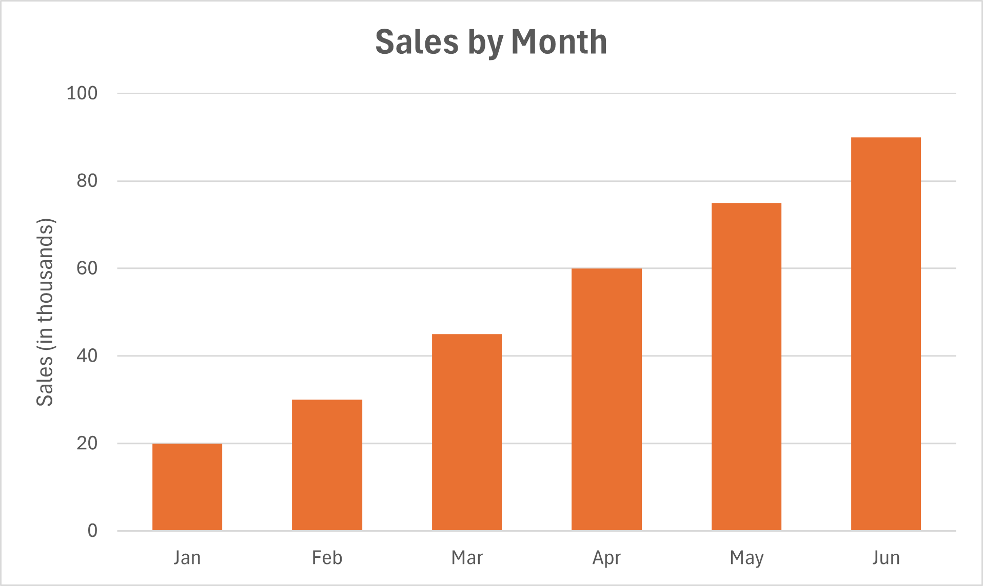
1.1 Text alternatives
  Provide text alternatives for any non-text content so that it can be changed into other forms people need.
  Non-text content needs meaningful alternatives
  Text alternatives support multiple ways of accessing information
  Descriptions should communicate purpose, not just appearance
  Accessible content becomes more flexible and adaptable
  Supports screen reader users and multimodal experiences
  WCAG SCs provide guardrails for equivalent alternatives
Alt text = “Sales chart”
Alt text = “Bar chart showing monthly sales in thousands from January to June, with orange bars increasing steadily from 20,000 in January to 90,000 in June. The chart highlights a consistent upward sales trend over six months, with sales nearly quadrupling by mid-year.”

Slide 14




1.2 Time-based Media
  Provide alternatives for time-based media.
  Media should be accessible beyond audio and visuals alone
  Captions and transcripts improve comprehension and flexibility
  Alternatives support different environments and preferences
  Synchronized media can create barriers without support
  Supports Deaf, hard of hearing, blind, and neurodivergent users
  WCAG SCs provide guardrails for captions and audio description

Slide 15

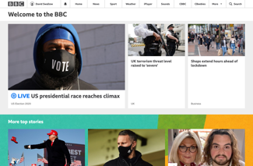
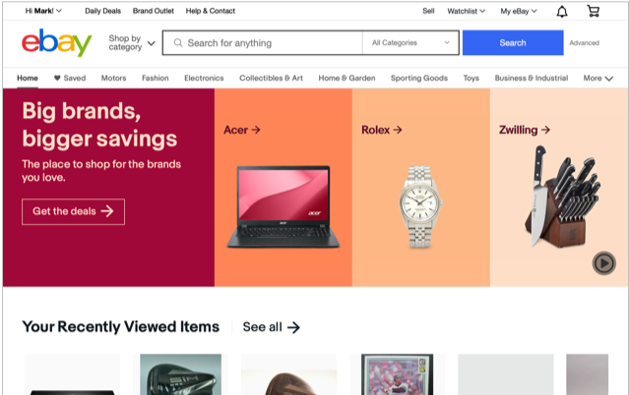

1.3 Adaptable
  Create content that can be presented in different ways without losing information or structure.
  Structure should remain meaningful across different presentations
  Semantic relationships support understanding and navigation
  Content should adapt without losing information or functionality
  Flexible layouts improve compatibility across devices and tools
  Supports assistive technologies and responsive experiences
  WCAG SCs provide guardrails for structure and relationships

Slide 16
1.4 Distinguishable
GOOD CONTRAST
  Make it easier for users to see and hear content, including separating foreground from background.
  Important content should stand out clearly
  Color alone should not communicate meaning
  Good contrast improves readability and focus
  Users need control over presentation and scaling
  Supports low vision, ageing, and situational accessibility
  WCAG SCs provide guardrails for visual and auditory clarity
GOOD CONTRAST
BAD CONTRAST
BAD CONTRAST

Slide 17
Operable UX

Slide 18


2.1 Keyboard Accessible
  Make all functionality available from a keyboard.
  Keyboard access supports independent interaction
  Users should not rely on precise pointer control
  Clear focus and logical navigation improve orientation
  Consistent keyboard behavior supports efficiency and confidence
  Supports screen reader, motor-impaired, and power users
  WCAG SCs provide guardrails for keyboard interaction

Slide 19
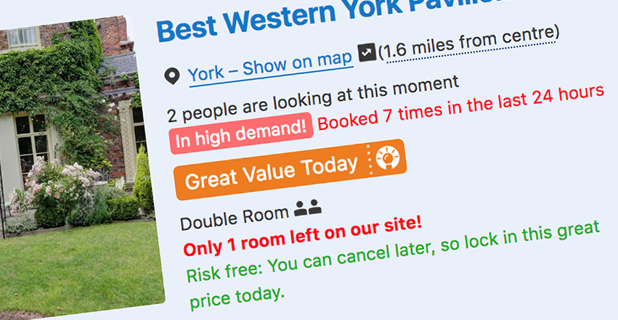
2.2 Enough Time
  Provide users enough time to read and use content.
  Users need time to read, understand, and respond
  Time limits can create stress and increase errors
  Users should be able to pause, extend, or control timing
  Moving or updating content should not disrupt focus
  Supports users with cognitive, visual, and motor disabilities
  WCAG SCs provide guardrails for timing and motion control

Slide 20

2.3 Seizures and Physical Reactions
  Do not design content in a way that is known to cause seizures or physical reactions.
  Motion and flashing content can cause physical harm
  Users should feel safe interacting with digital products
  Unexpected animation can create distraction and discomfort
  Motion should support tasks rather than compete with them
  Supports users with vestibular disorders and photosensitivity
  WCAG SCs provide guardrails for flashing and motion

Slide 21
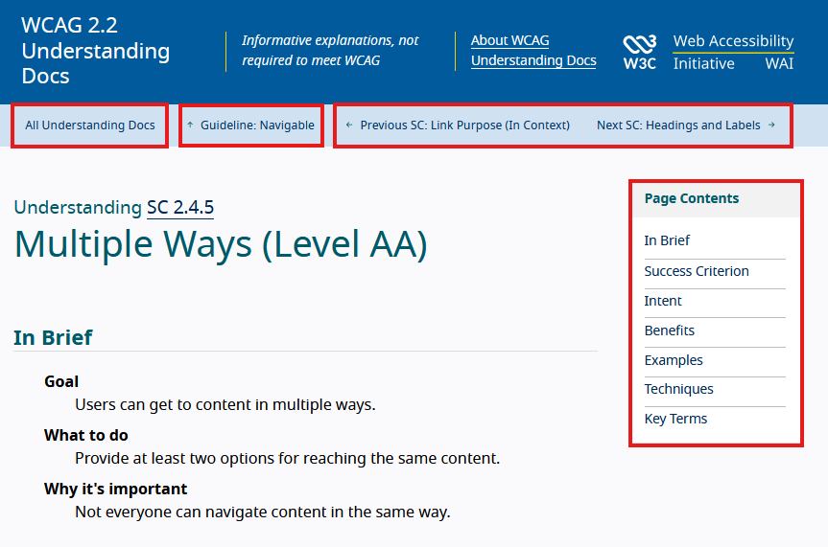
2.4 Navigable
  Provide ways to help users navigate, find content, and determine where they are.
  Clear navigation supports orientation and confidence
  Users should always know where they are
  Consistent structure improves efficiency and learnability
  Focus visibility and page structure aid navigation
  Supports screen reader, keyboard, and cognitive accessibility
  WCAG SCs provide guardrails for navigation and focus

Slide 22
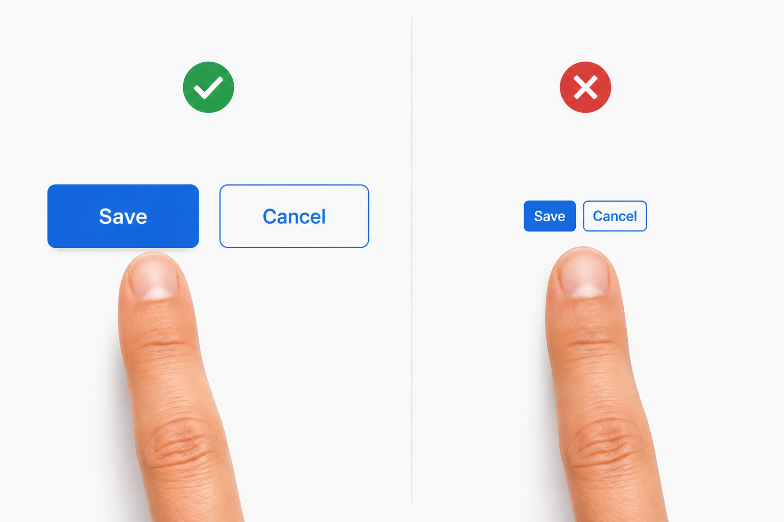
2.5 Input Modalities
  Make it easier for users to operate functionality through various inputs beyond keyboard.
  Users interact through many different input methods
  Interfaces should support touch, voice, pointer, and gesture input
  Complex gestures can create unnecessary barriers
  Controls should be easy to activate accurately
  Supports mobile accessibility and motor accessibility
  WCAG SCs provide guardrails for flexible interaction

Slide 23
Understandable UX

Slide 24
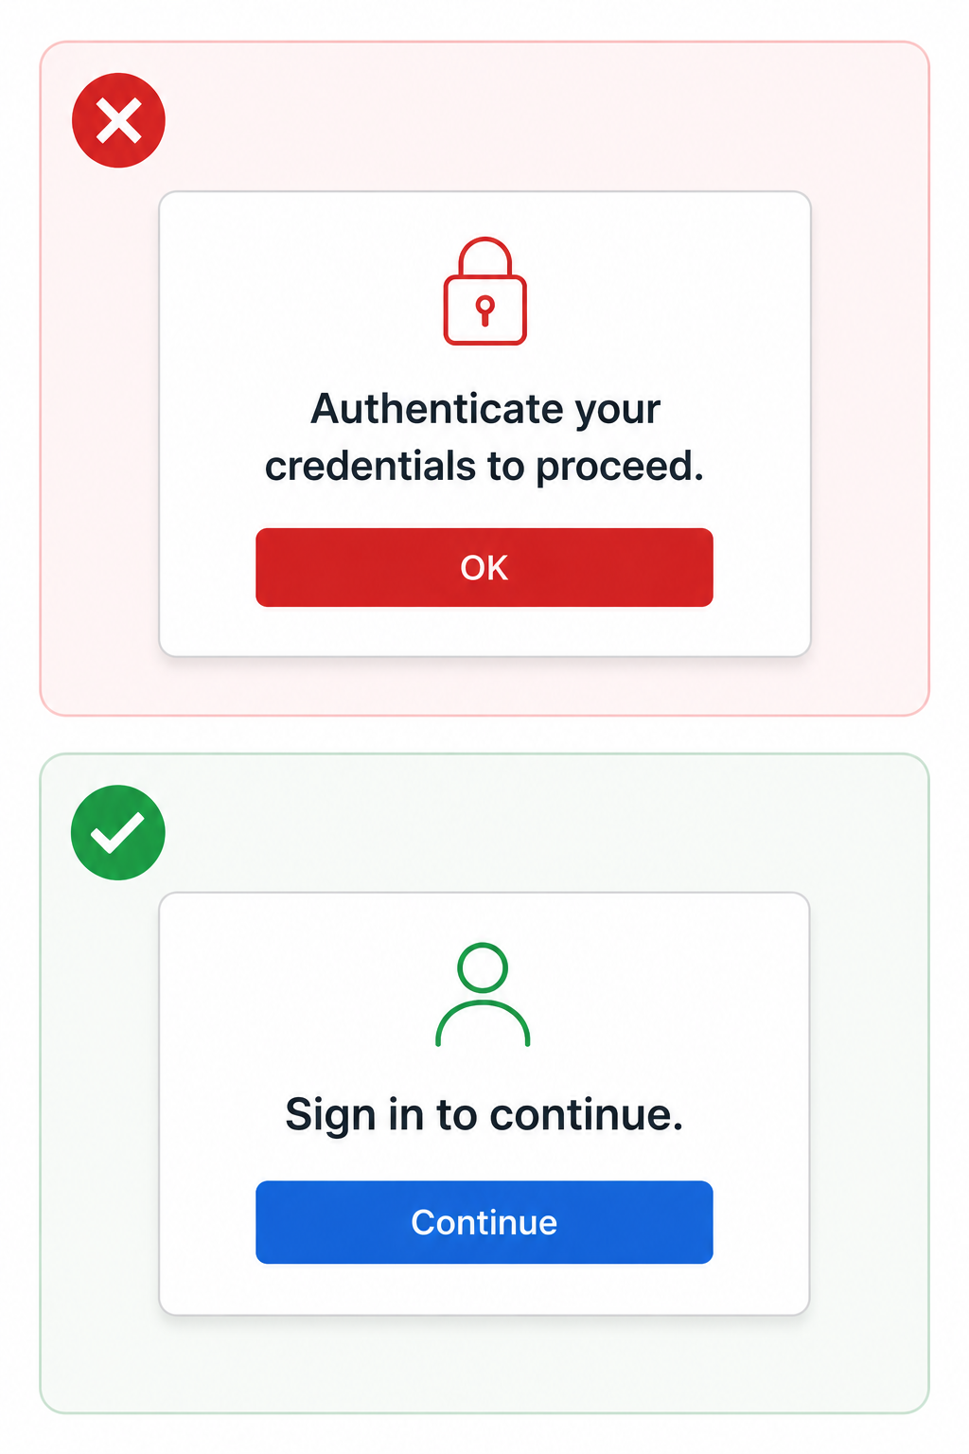
3.1 Readable
  Make text content readable and understandable.
  Clear language supports confident task completion
  Consistent wording reduces cognitive effort
  Plain language improves comprehension and scanning
  Explanations for jargon and abbreviations aid understanding
  Supports users with different literacy, language, and cognitive needs
  WCAG SCs provide measurable readability guardrails

Slide 25
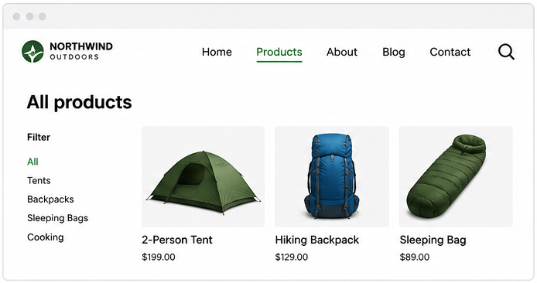
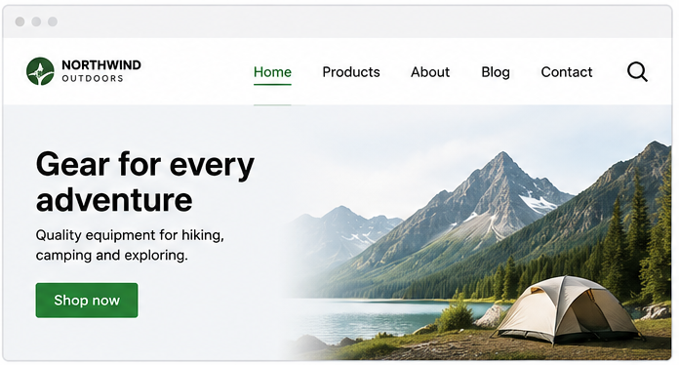
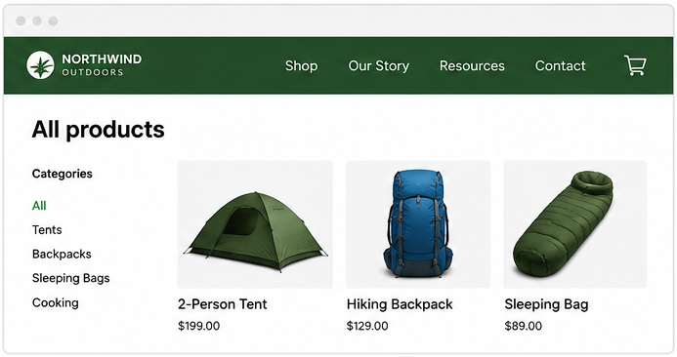
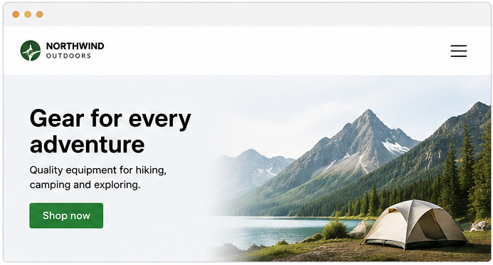
3.2 Predictable
  Make web pages appear and operate in predictable ways.
  Consistent interactions build user confidence
  Predictable behavior reduces cognitive effort
  Navigation and controls should behave as expected
  Unexpected changes can disrupt orientation and task flow
  Supports users with cognitive, visual, and motor disabilities
  WCAG SCs provide guardrails for consistent interaction patterns

Slide 26
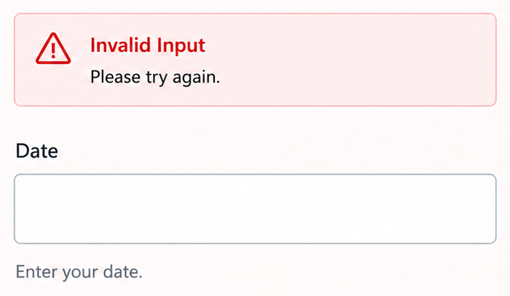
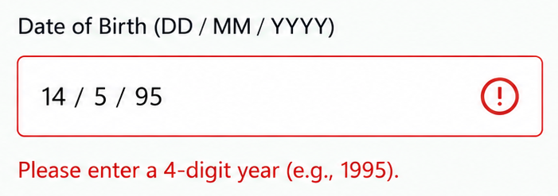
3.3 Input Assistance
  Help users avoid and correct mistakes.
  Clear guidance supports accurate task completion
  Helpful validation reduces frustration and abandonment
  Errors should be easy to identify and recover from
  Instructions and feedback should appear at the right time
  Supports users with cognitive, visual, and motor disabilities
  WCAG SCs provide guardrails for error prevention and recovery

Slide 27
Robust UX

Slide 28

4.1 Compatible
  Maximize compatibility with current and future user agents, including assistive technologies.
  Reliable code supports reliable user experiences
  Semantic markup improves compatibility and interoperability
  Assistive technologies depend on predictable programmatic information
  Accessible foundations improve resilience and adaptability
  Supports long-term usability across technologies and platforms
  WCAG SCs provide guardrails for compatibility and interoperability

Slide 29
3. Integrating accessibility into UX processes

Slide 30
Include accessibility in upfront research and requirements definition
  When research is intended to inform what you build, include people with disabilities in research activities
  When defining requirements in terms of:
    Functionality
    Performance
    Support (including assistive technology)
    Acceptance criteria, definitions of done

Slide 31


Include people with disabilities in representations of users
  Personas
  Scenarios
  Product marketing materials

Slide 32
Include people with disabilities in co-design activities
  When design activities involve target users, include people with disabilities
  If possible, include disabled researchers, designers, developers, testers, managers, in the product team
    But don't rely on them for all accessibility efforts

Slide 33
Include people with disabilities when evaluating what you've built
  Usability evaluations of:
    Ideas, concepts, early prototypes
    Functional prototypes
    Beta versions
    Instructions and user guidance
  Make sure evaluations reflect real-world conditions as far as possible

Slide 34
Include stakeholders in accessible UX efforts
  Training
    Include WCAG's guidelines in accessibility training
  Participation
    Invite all the product team to participate in activities involving people with disabilities
    Capture and share experiences - bad and good

Slide 35
4. Summary

Slide 36
Key points
  Inclusive user experiences are what people (users, businesses, governments, investors) need
  The Web Content Accessibility Guidelines' Guidelines can help you connect accessibility to user experience for your product's specific context
  Integrate accessibility into user experience research, design, and development for more inclusive products!

Slide 37
Questions

